Slide 1





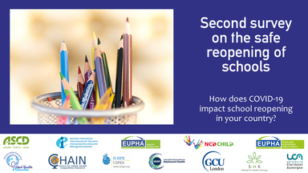
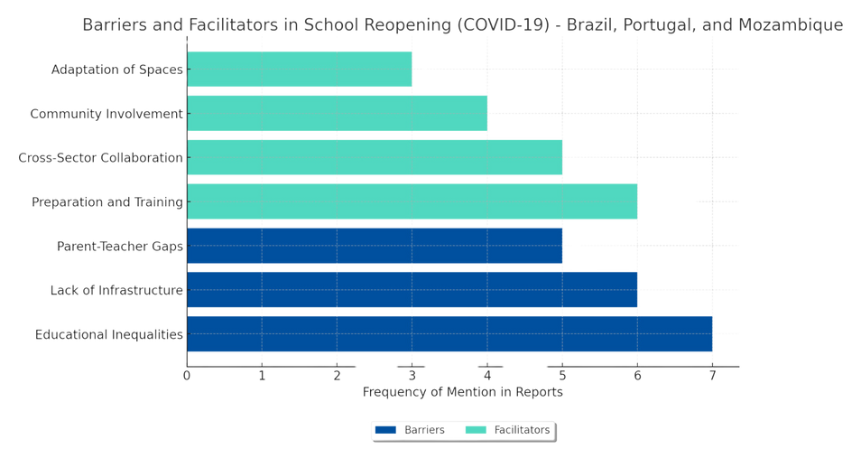

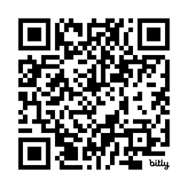
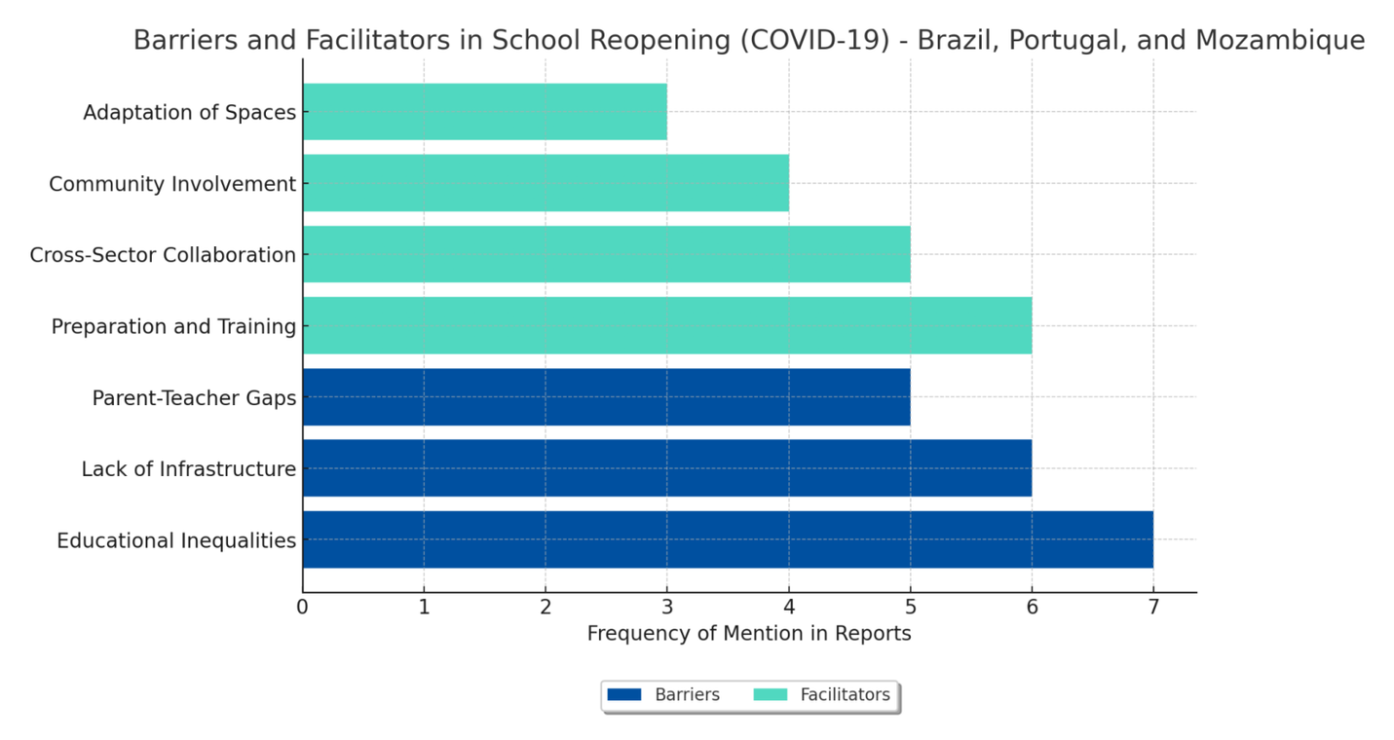

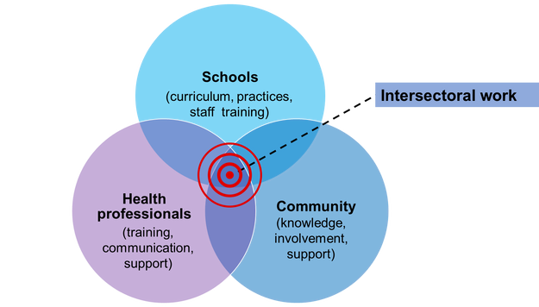




ORGANISATION OF SCHOOL ENVIRONMENT ON REOPENING SCHOOLS AMIDST COVID-19: BARRIERS AND FACILITATORS
Roberto T. Iaochite (1), Mayara M. Matos(2), Roraima A. Costa Filho(3), Graça S. Carvalho(4),
Zélia Anastácio(4), Regina F. Alves(4), Manecas Azevedo(5), Leonel Oliveira(6)
(1) Sao Paulo State University, Brazil, (2) Federal University of Alfenas, Brazil, (3) Rio Claro Municipal Department of Education, Brazil
(4) University of Minho, Portugal, (5) University Rovuma, Mozambique, (6) University of Évora, Portugal
KEY CONCLUSIONS
RESULTS
Educational Inequalities: Public schools faced more barriers
Barriers: Inadequate infrastructure; educational inequalities
Facilitators: Staff thoroughly prepared for new protocols; strong collaboration between education and health sectors; community engagement played a critical role; adaptation of classrooms and school spaces ensured safety.
Key message: Collaboration in this study highlights the complex challenges and necessary strategies for safely reopening schools during a pandemic, emphasizing the critical role of thorough preparation and community engagement in addressing educational disparities during crises.
"We trained the teachers to work with new technologies and adapt content for remote learning." — School Administrator, Brazil
"The community was essential in helping us adapt the schools and ensure the children could return safely." — School Administrator (Male), Mozambique
To learn more...
Adaptation of space
Community involvement
"Many families do not have access to the internet, making remote learning impossible in some areas." — Teacher (Female), Brazil
"Communication between teachers and parents was extremely difficult due to the lack of technological resources." — Teacher (Male), Portugal
Intersector collaboration
Preparation / Training
Parents-teacher gaps
Lack of infrastructure
BACKGROUND
Educational infrastructure
The reopening of schools during COVID-19 had a significant global impact, affecting millions. Led by the UNESCO Chair Global Health and Education, this study focuses on organizing safe school environments in Portuguese-speaking countries, including Brazil, Portugal, and Mozambique, to ensure education continuity.
Figure 1. Facilitators and barriers
Conclusions
Address educational disparities and improve infrastructure in public schools.
Enhance intersectoral work between education and health.
Prioritise staff training and community engagement for future crises.
METHODOLOGY
Twelve interviews (teachers, educational managers, and health professionals)—Brazil, Portugal, and Mozambique.
Thematic analysis using NVivo v.22.0.
Protocol approved by the IRB of the University of Clermont-Auvergne no. IRB00011540-2020-65 (available at UNESCO Chair GHE).
roberto.iaochite@unesp.br
Figure 2. Intersectoral work

