Slide 1

What do we know about the health and well-being of education personnel worldwide?
There is no well-being without well-doing!

Slide 2











Five ideas to share
Professions that are particularly exposed to social and environmental change.
There is no well-being without well-doing!
Where are the 69 million missing education professionals?
Taking action for the health and well-being of education professionals: an investment!
What contributes to the health and well-being of education professionals?
What do we know about the health and well-being of education personnel worldwide?

Slide 3
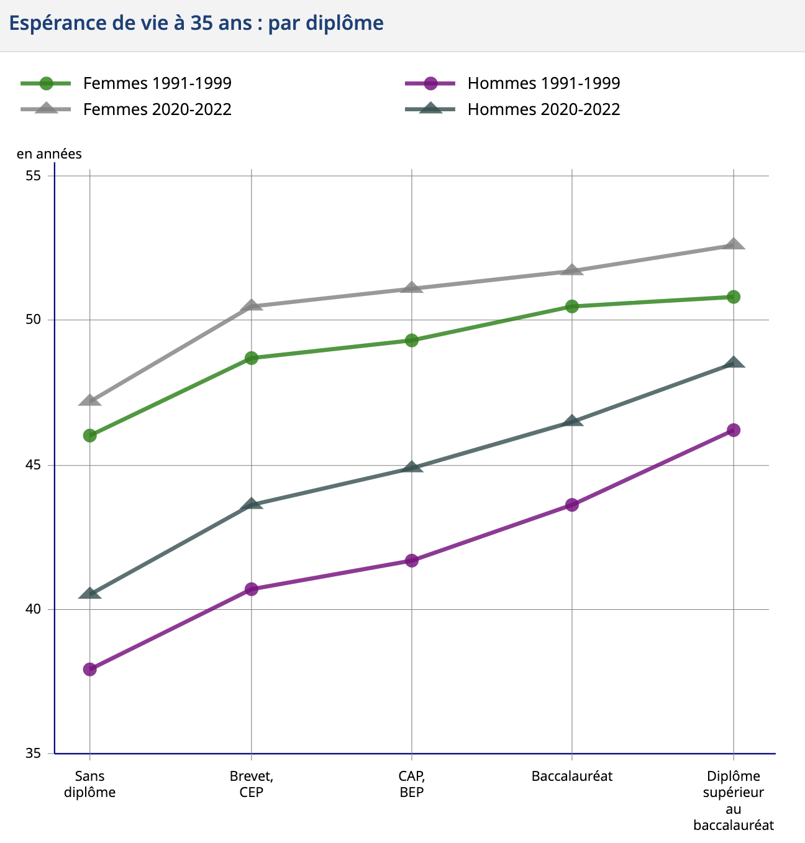
Professions particularly exposed to social and environmental change
Teachers have higher-than-average qualifications and a good life expectancy.
However, fewer than one in two personnel 'agree' or 'strongly agree' with the statement 'on the whole, I am satisfied with my job'.
INSEE 2022
What do we know about the health and well-being of education personnel worldwide?

Slide 4

Professions particularly exposed to social and environmental change
A worrying state of psychological health (anxiety, depression, despair, burn out, etc.)
Exposure to violence (physical or moral / online)
A difficult personal/professional life balance
Voice disorders
I-BEST 2023, Tsai et al. 2023
What do we know about the health and well-being of education personnel worldwide?

Slide 5
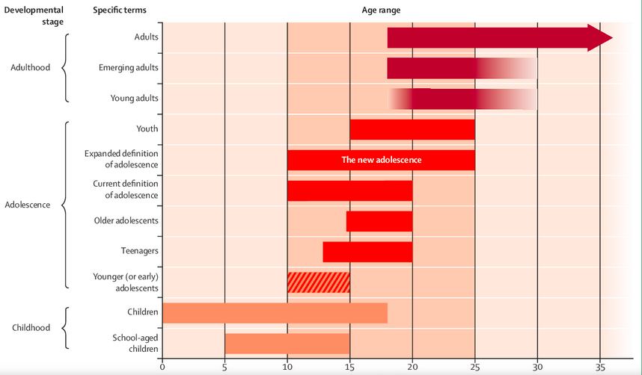
Sawyer et al., 2018

Slide 6

© NASA

Slide 7


Professions particularly exposed to social and environmental change
Global mega-trends
  Ecological transition
  Technological transition
  Demographic transition
  Epidemiological transition
  Urbanisation
  Nutritional transition
  Globalisation of commercial interests
  Conflicts and wars
  ...
Klein 2022
What do we know about the health and well-being of education personnel worldwide?

Slide 8
Professions particularly exposed to social and environmental change
  Major social developments
  Education policies
  Human resources management
  Plant management
  Recruitment, training and support
Health and well-being of education professionals
What do we know about the health and well-being of education personnel worldwide?

Slide 9
Five ideas to share
Professions that are particularly exposed to social and environmental change.
There can be no well-being without doing well!
Where are the 69 million missing education professionals?
Taking action for the health and well-being of education professionals: an investment!
What contributes to the health and well-being of education professionals?
What do we know about the health and well-being of education personnel worldwide?

Slide 10
Where are the 69 million missing education professionals?
The total number of teachers rose from 62 million to 94 million between 2000 and 2019
69 million teachers needed to achieve universal primary and secondary education by 2030
A challenge in terms of attractiveness: 13% of teachers in primary schools are under 30, compared with 11% and 8% respectively in secondary schools.
A retention challenge: between 2015 and 2022, attrition rates among primary school teachers doubled from 4.6% to 9%.
A challenge in the second half of the career: as they get older, professionals become more experienced but face difficulties due to the changes associated with advancing age.
OECD 2017, UNESCO 2020, Tsai et al. 2022
What do we know about the health and well-being of education personnel worldwide?

Slide 11

Where are the 69 million missing education professionals?
The well-being of teachers is essential to promote retention
Poor working conditions, combined with excessive workloads and feelings of isolation, can lead to dissatisfaction, burnout and attrition. In five English-speaking OECD countries, a clear correlation has been established between both objective and subjective working conditions - primarily workload - and well-being.
UNESCO 2023
What do we know about the health and well-being of education personnel worldwide?

Slide 12
Five ideas to share
Professions that are particularly exposed to social and environmental change.
There can be no well-being without doing well!
Where are the 69 million missing education professionals?
Taking action for the health and well-being of education professionals: an investment!
What contributes to the health and well-being of education professionals?
What do we know about the health and well-being of education personnel worldwide?

Slide 13

Determinants of the health of education professionals
The determinants of health

Slide 14
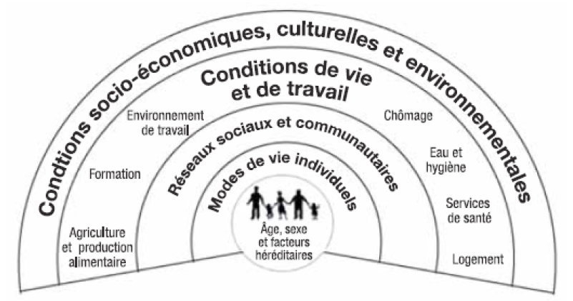


Determinants of the health of education professionals
Living and working conditions are at the heart of what determines health, while the health care system accounts for less than 20% of health determinants.

Slide 15

Taking action for the health of education professionals
An environment and working conditions conducive to health and well-being
Capacity building initiatives
Access to prevention and health care services
What do we know about the health and well-being of education personnel worldwide?

Slide 16
Five ideas to share
Professions that are particularly exposed to social and environmental change.
There can be no well-being without doing well!
Where are the 69 million missing education professionals?
Taking action for the health and well-being of education professionals: an investment!
What contributes to the health and well-being of education professionals?
What do we know about the health and well-being of education personnel worldwide?

Slide 17


There is no well-being without well-doing!
Millefeuille
Mayonnaise
The challenge of coherence, working conditions and professional identity
What do we know about the health and well-being of education personnel worldwide?

Slide 18
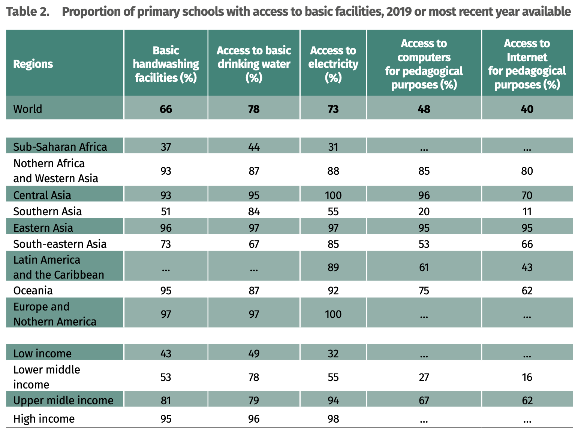
Taking action for the health of education professionals
An environment and working conditions conducive to health and well-being
  Workload and resources
  School management
  The school environment
  The school climate
  Access to prevention services
A school-wide approach to health promotion
UNESCO, 2020
What do we know about the health and well-being of education personnel worldwide?

Slide 19
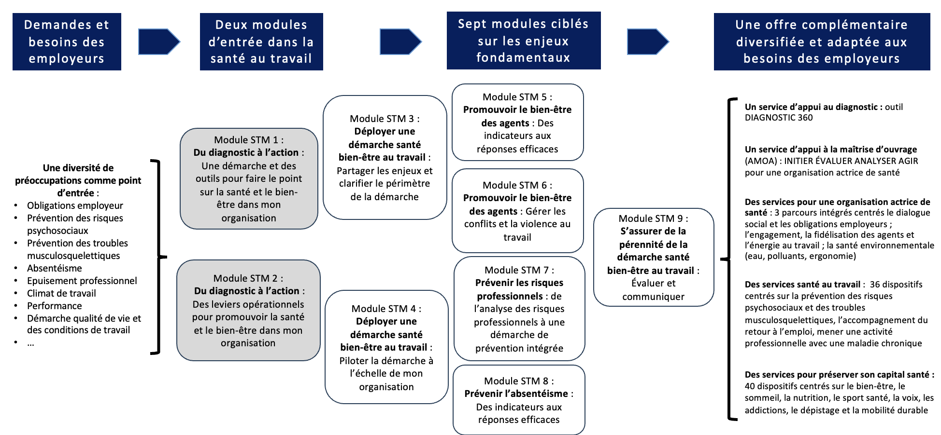
Taking action for the health of education professionals
Capacity building initiatives
  Training and support services
  Voice, ergonomics, occupational health, conflict management, well-being, physical activity...
Lehr et al. 2016 Mañas Mañas, et al. 2011; Roeser, et al. 2012
What do we know about the health and well-being of education personnel worldwide?

Slide 20

Taking action for the health of education professionals
Access to prevention and health care services
Occupational medicine
Occupational health services: prevention of psychosocial risks and musculoskeletal disorders, support in returning to work, working with a chronic illness, etc.
MGEN 2024
What do we know about the health and well-being of education personnel worldwide?

Slide 21
Five ideas to share
Professions that are particularly exposed to social and environmental change.
There can be no well-being without doing well!
Where are the 69 million missing education professionals?
The health and well-being of education professionals: an investment!
What contributes to the health and well-being of education professionals?
What do we know about the health and well-being of education personnel worldwide?

Slide 22

The health and well-being of education professionals: an investment!
There is a negative association between :
symptoms of teacher burnout
stress
and students' academic results.
Herman et al. 2018, Klusmann et al. 2021
What do we know about the health and well-being of education personnel worldwide?

Slide 23
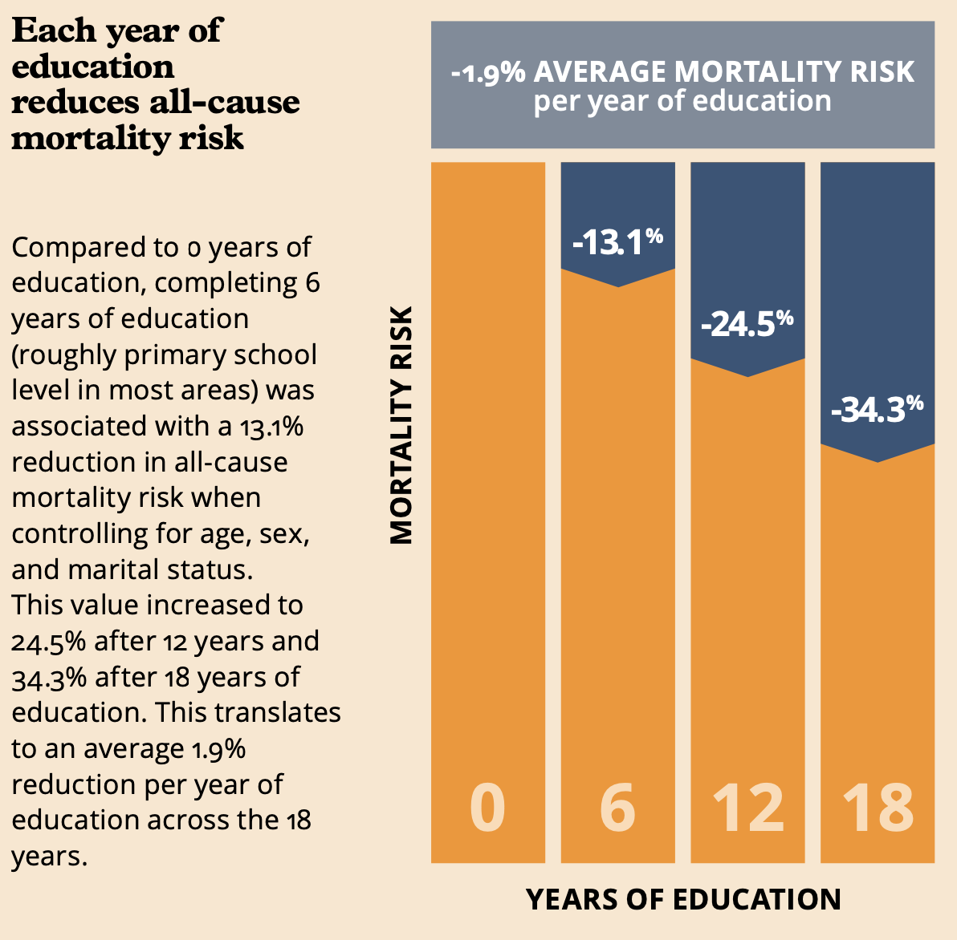
The health and well-being of education professionals: an investment!
Education is one of the main determinants of health.
A complete education reduces the risk of mortality by 34% compared with no education at all!
The Lancet Public Health, 2024
What do we know about the health and well-being of education personnel worldwide?

Slide 24

You think education is expensive? Try ignorance!
According to UNESCO-OECD-Commonwealth’s Price of Inaction report, children leaving school early has a major impact on the wellbeing of societies as well as economies. However, if governments were to ensure that every child stayed in school and achieved basic skills, the world’s GDP could increase by more than US$6.5 trillion annually.
One of the keys to ensuring children stay in school and learn is hiring qualified, motivated and diverse teachers who engage all students equally, and can unlock their potential.
UNESCO, 2024
What do we know about the health and well-being of education personnel worldwide?

Slide 25
Cost-effectiveness and return on investment of a prevention programme
The introduction of the programme for the prevention of musculoskeletal disorders and illnesses (PAMAL) offered to pre-school education personnel has led to a reduction in musculoskeletal disorders among personnel and a reduction in absenteeism.
In addition to the benefits in terms of human resources (productivity, working conditions, attractiveness, etc.), the return on investment for the employer is positive: €1 invested in training saves €3.14 in direct costs.
MNT 2022
What do we know about the health and well-being of education personnel worldwide?

Slide 26
Cost-effectiveness and return on investment of health promotion programmes in schools
The return on investment, thanks to the avoidance of direct healthcare costs associated with the treatment and management of chronic diseases, would be 824% for comprehensive programmes, 465% for multi-component interventions and 484% for interventions aimed at modifying the physical education curriculum.
A school-wide approach to health promotion
Ekwaru et al. 2021
What do we know about the health and well-being of education personnel worldwide?

Slide 27
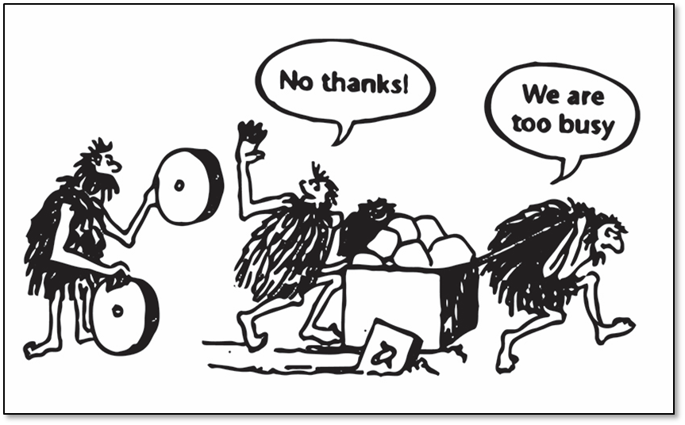
Towards practices that truly promote the health of all students
The health and well-being of education professionals: an investment!

Slide 28
Health, well-being and working conditions
Education policies
Mobilising civil society
Steering education systems
Policies
Educational practices
School
management
Structures and systems
Practices
Management practices
Prevention services
Human resources
Recruitment and training
Professional support
What do we know about the health and well-being of education personnel worldwide?

Slide 29
Nothing about teachers without teachers!
“Teachers are central to nurturing every country’s greatest resource: the minds of its people. Yet today, we face a dramatic shortage of teachers worldwide, and millions of teachers who lack the support, skills and continuing training they need to meet the demands of rapidly changing education systems.”
"If I want to succeed in guiding someone towards a specific goal, I have to look for them where they are and start there, right there. Anyone who doesn't know how to do that is deceiving himself when he thinks he can help others.”
António Guterres
Søren Kierkegaard
What do we know about the health and well-being of education personnel worldwide?

Slide 30
What do we know about the health and well-being of education personnel worldwide?
There is no well-being without well-doing!

