Slide 1

HEALTH PROMOTION SOUTH AFRICA TRUST (HEALTH PROMOTERS)
BASIC HEALTH EDUCATION COURSE
PRESENTED BY GEORGE ARREY.
HEALTH PROMOTERS
HAVE A PARTNERSHIP WITH

Slide 2
HPSA Basic Health Education(BHE) Course
The HPSA Basic Health Education (BHE) course consists of 12 compulsory workshops and 10 optional workshops. The compulsory workshops educate people in all the essentials of good health principles and healthy lifestyle practices, as well as teaching how to prevent and manage the major infectious and non-communicable diseases. The optional workshops address health issues that apply to particular sectors of the population (gender, adolescents, parents, elders etc.).
We teach, on a simple level, the various systems and organs of the body and how to keep them healthy in each topic. So, each workshop introduces the relevant system/organ, how to keep it/them healthy, followed by an explanation of the most common illnesses relating to the system, and healthy ways of coping with such illnesses and managing disease, as a whole. Each workshop builds on knowledge learnt in the previous workshop, which facilitates more in-depth learning. So, the compulsory topics are taught in sequence, but the optional topics can be taught in any order, once the compulsory workshops are completed.

Slide 3
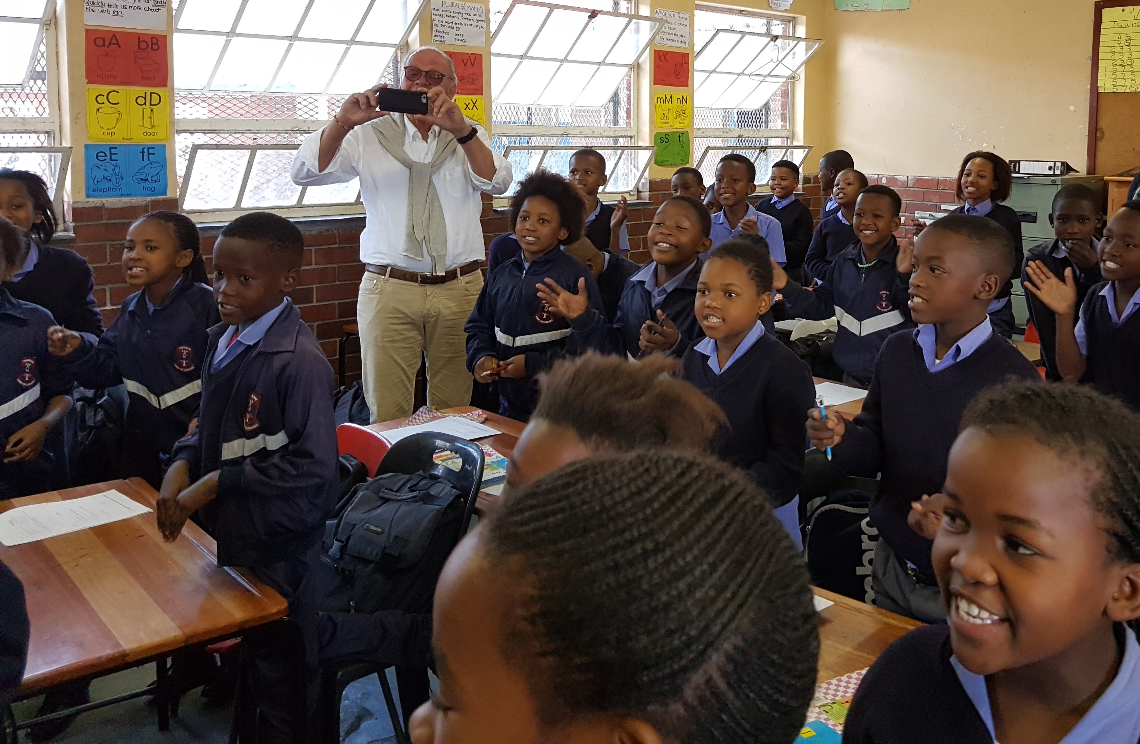
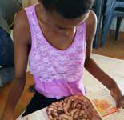
The HP @ Programs
HP@SCHOOL:
This program seeks to help both pupil and teachers understand the endemic health issues that are plaguing their school and community, especially the former, and how they may be prevented. Topics taught range from puberty/body changes to first aid.
HP@CRECHE:
Here, the care givers are taught basic health and hygiene measures to enable them cater for the kids in their care.

Slide 4
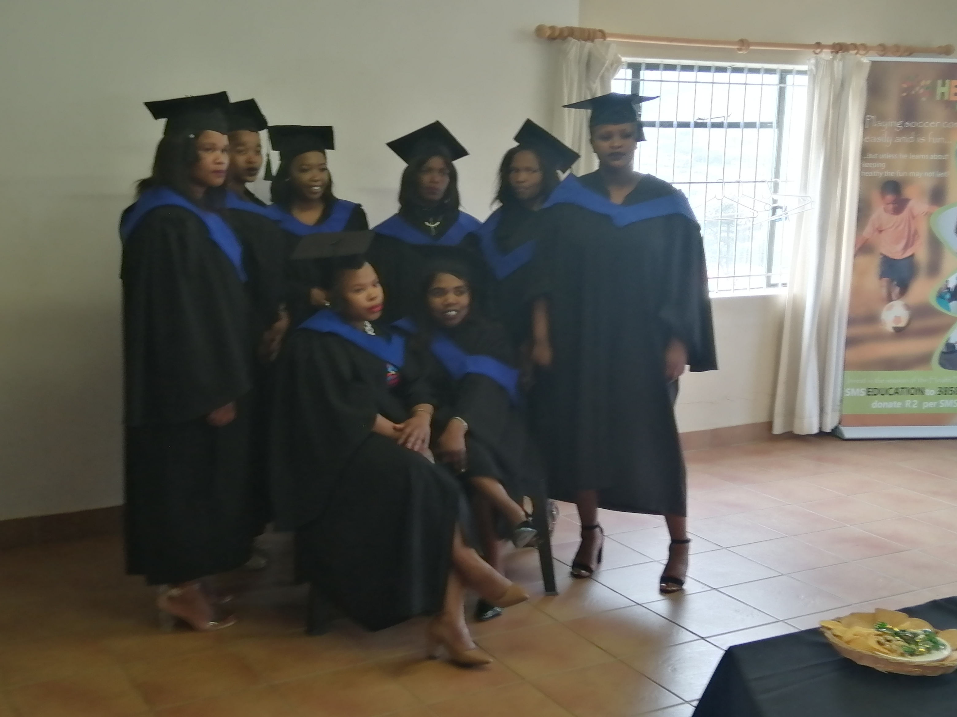
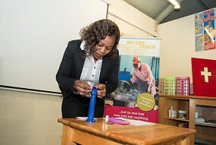
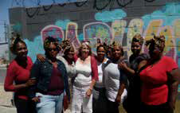
HP@Community:
This program targets mostly adolescents, younger adults and older adults. It involves most of the workshops that are organized at our health information centers, aimed at teaching ways to prevent and /or successfully manage diseases that are endemic to our target communities. Diseases such as HIV & AIDS, TB, Obesity, Sexually transmitted Infections, Cardiovascular diseases, Hypertension etc.
GrowStronger:
This is a psychosocial program aimed at helping women and girls navigate the rough socio-economic terrain of the townships. It is a 10 weeks course and mostly attended by women who have first completed our BHE course.

Slide 5



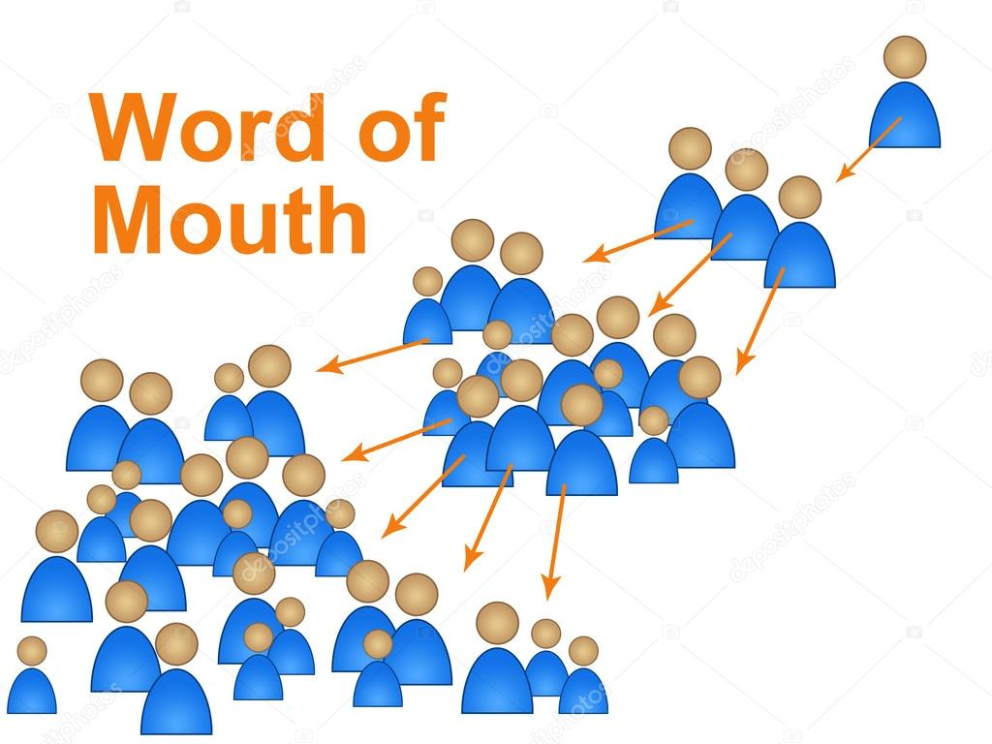

HP@COMMUNITY
Advertisement media(recruitment).

Slide 6
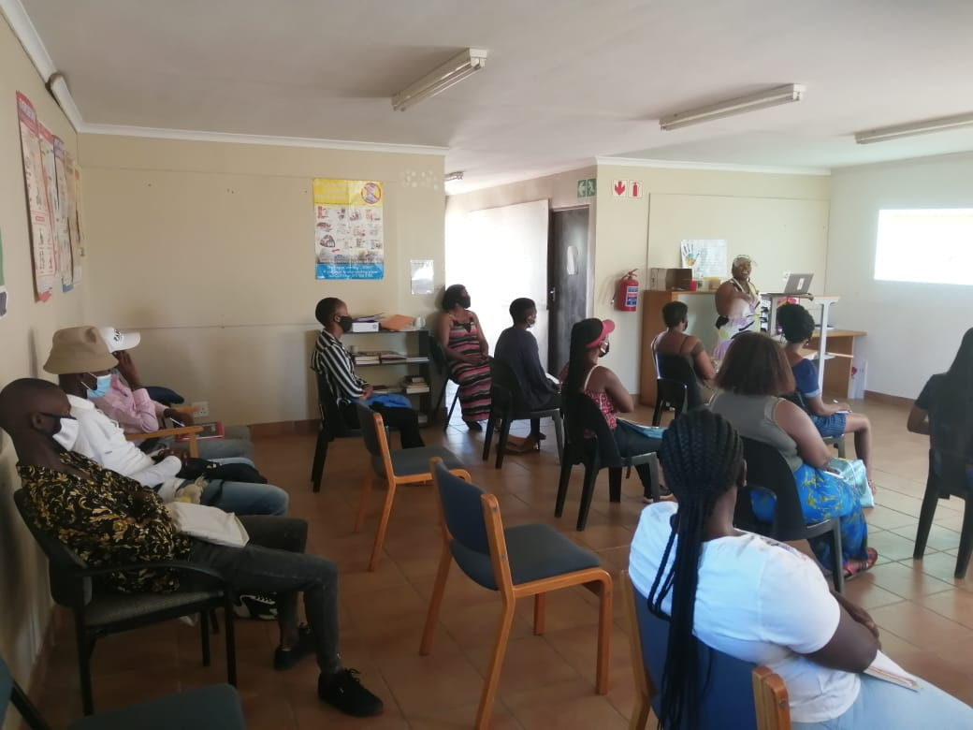
SIYAHKA GROUP

Slide 7
Introductory session:
BHE COMPULSORY TOPICS
12 BASIC HEALTH EDUCATION COMPULSORY TOPICS (Participants must do ALL these workshops)
1 HYGIENE AND HEALTH This workshop covers the prevention of infectious diseases by teaching sound hygiene practices. Prevention and management of diarrhea and dehydration is also covered.
2 SAFETY AND FIRST AID This workshop looks at basic first aid techniques, as well giving an overview of safety practices that can prevent injury and death.
3 HEALTHY EATING In this workshop the digestive system is introduced along with healthful nutrition. Gastritis and malnutrition are also discussed. Thrifty ways of planning healthy food is presented.
4 HEALTHY HEARTS This topic teaches about the heart and the circulatory system, and how to keep this system healthy and avoid disease. The various heart / blood vessel diseases and their management are discussed.
5 HEALTHY LUNGS Here participants learn about the respiratory system and how to keep lungs healthy, including how to prevent TB, and how to manage TB when contracted. Smoking and its effect on lungs is also included in this topic.

Slide 8
BHE Optional topics
10 optional topics:
13 HEALTHY PREGNANCY Here a more in depth understanding of healthy pregnancy is taught than in the compulsory session, including how to keep mother and fetus/baby healthy (including childbirth, breast feeding, miscarriages)
14 HEALTHY SEX : AVOIDING SEXUAL ABUSE This workshop aims at helping women (mostly) to prevent/report/anticipate/guard against/ recover from sexual abuse.
15 HEALTHY SEX FOR YOUNG CHILDREN This is a specially designed workshop for little ones on the reproductive system including preventing sexual abuse, etc.
16 ORAL HEALTH This is a very practical and comprehensive look at how to prevent dental health issues, as well as when/where to go for help with fixing dental problems.
17 HEALTHY TEEN YEARS This workshop looks at adolescent strengths, peer pressure, the pain and joy of being a teenager. Emotional growth and adverse emotional health issues are explored, along with ways of recognizing depression and suicidal ideation.

Slide 9
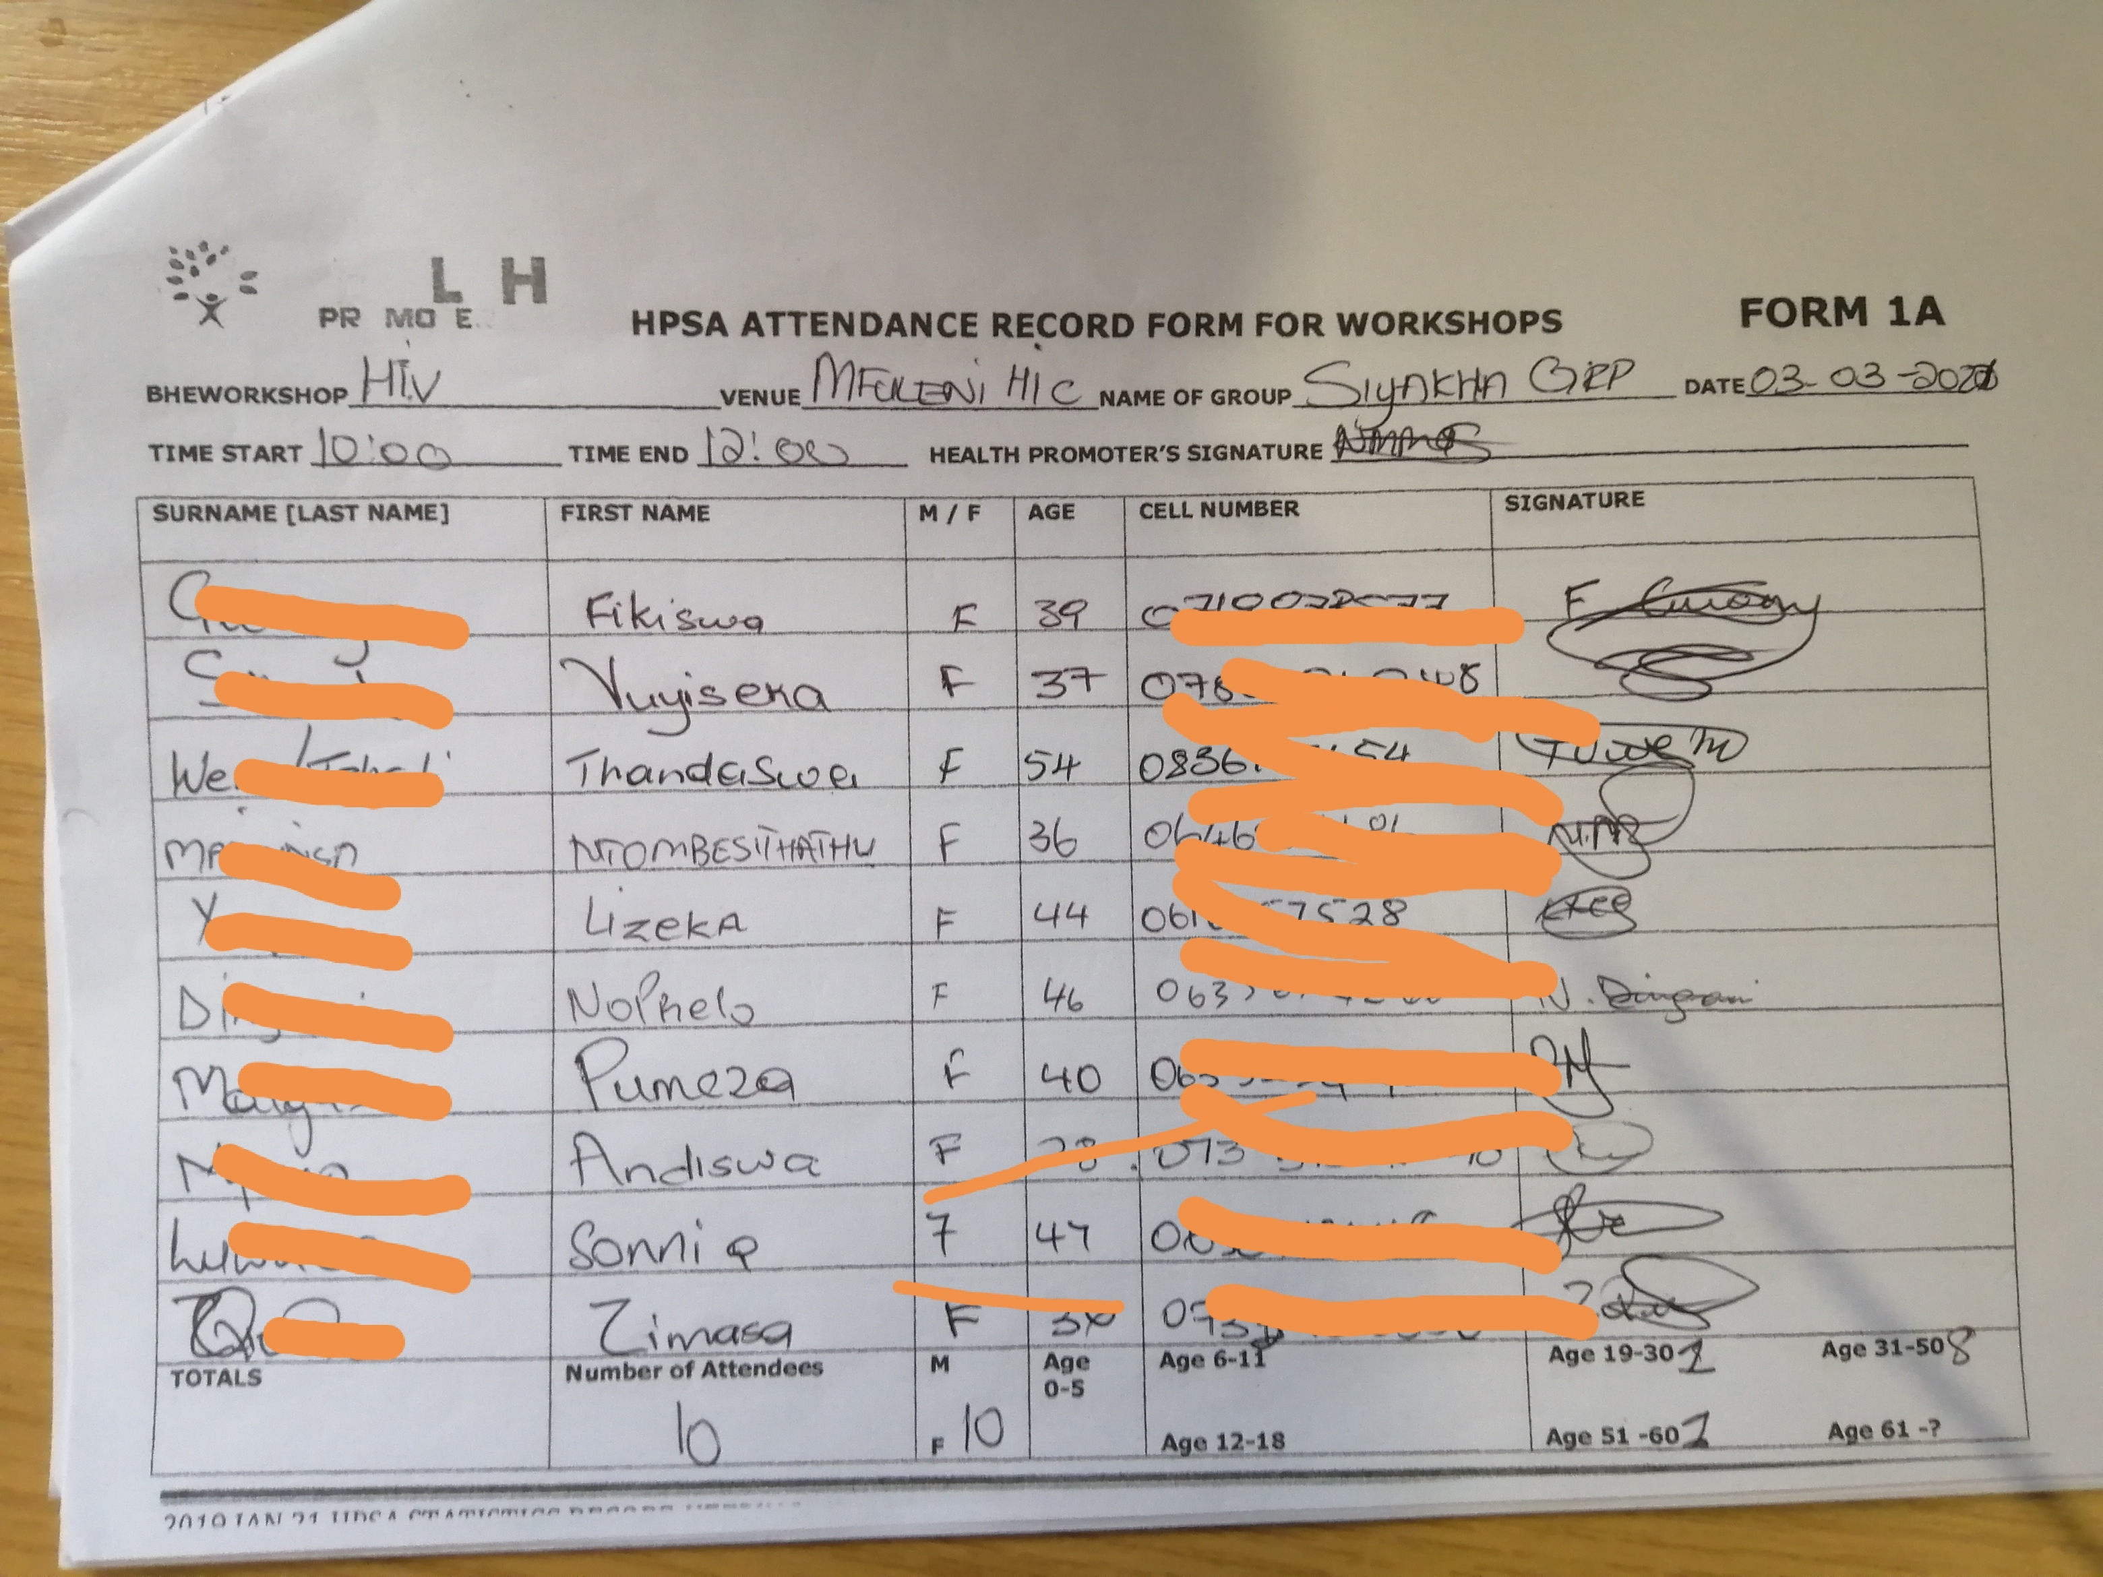
ATTENDANCE REGISTER

Slide 10
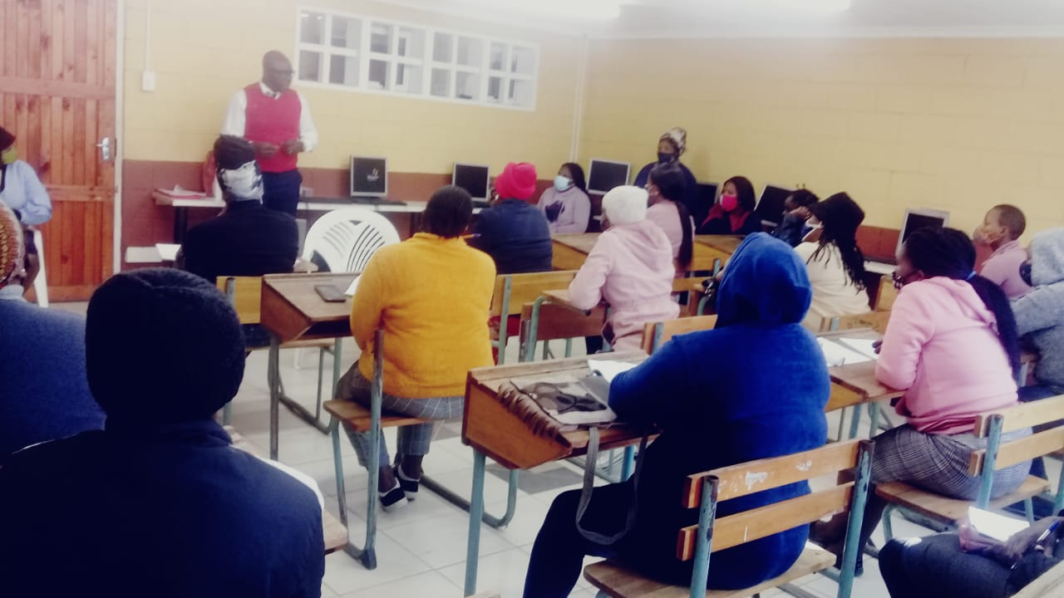
TYPICAL SESSION(highly interactive)
-power point presentation.
-role play
-story telling
-webinars
-social media

Slide 11


HPSA ASSESSMENT(oral & written)

Slide 12


HPSA DATA CAPTURING

Slide 13
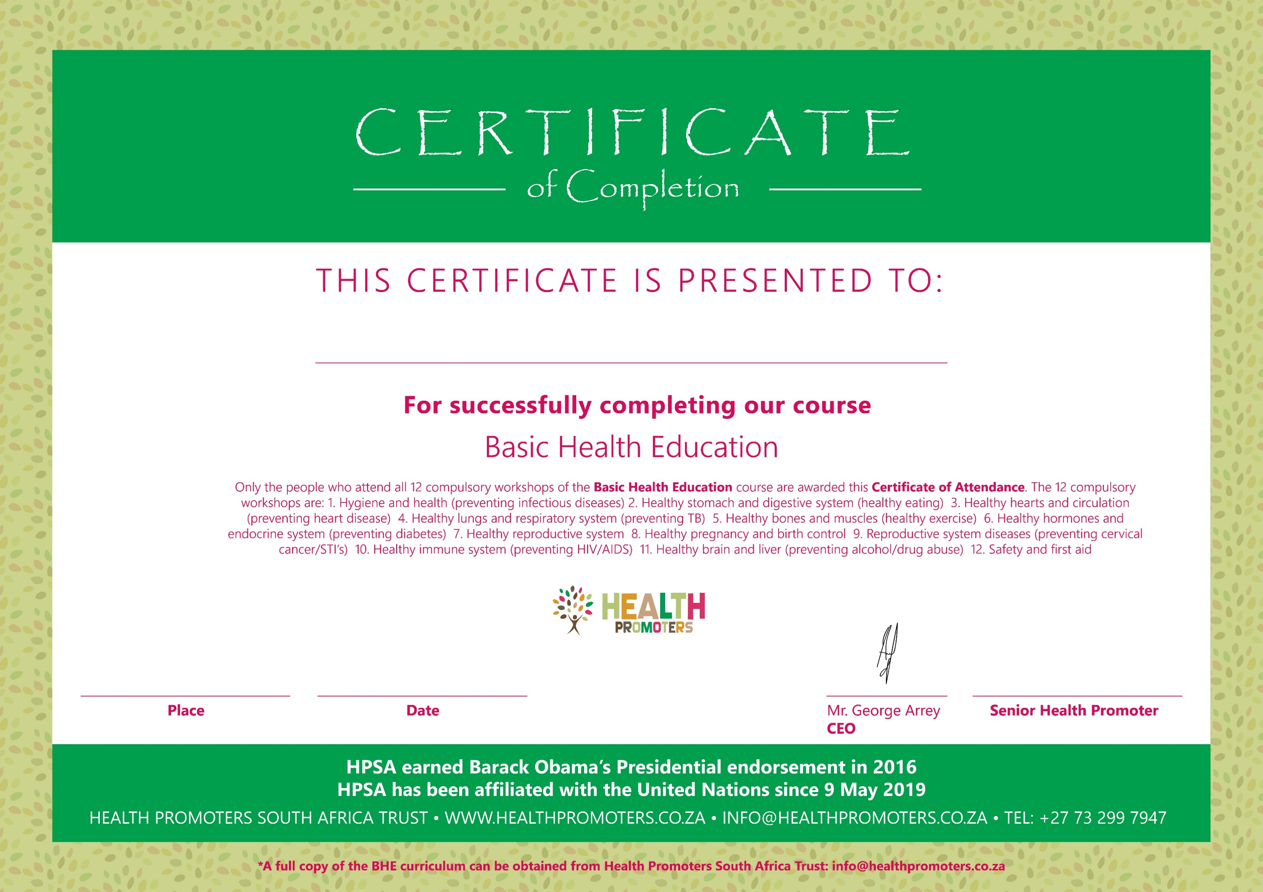
HPSA TEMPLATE CERTIFICATE

Slide 14
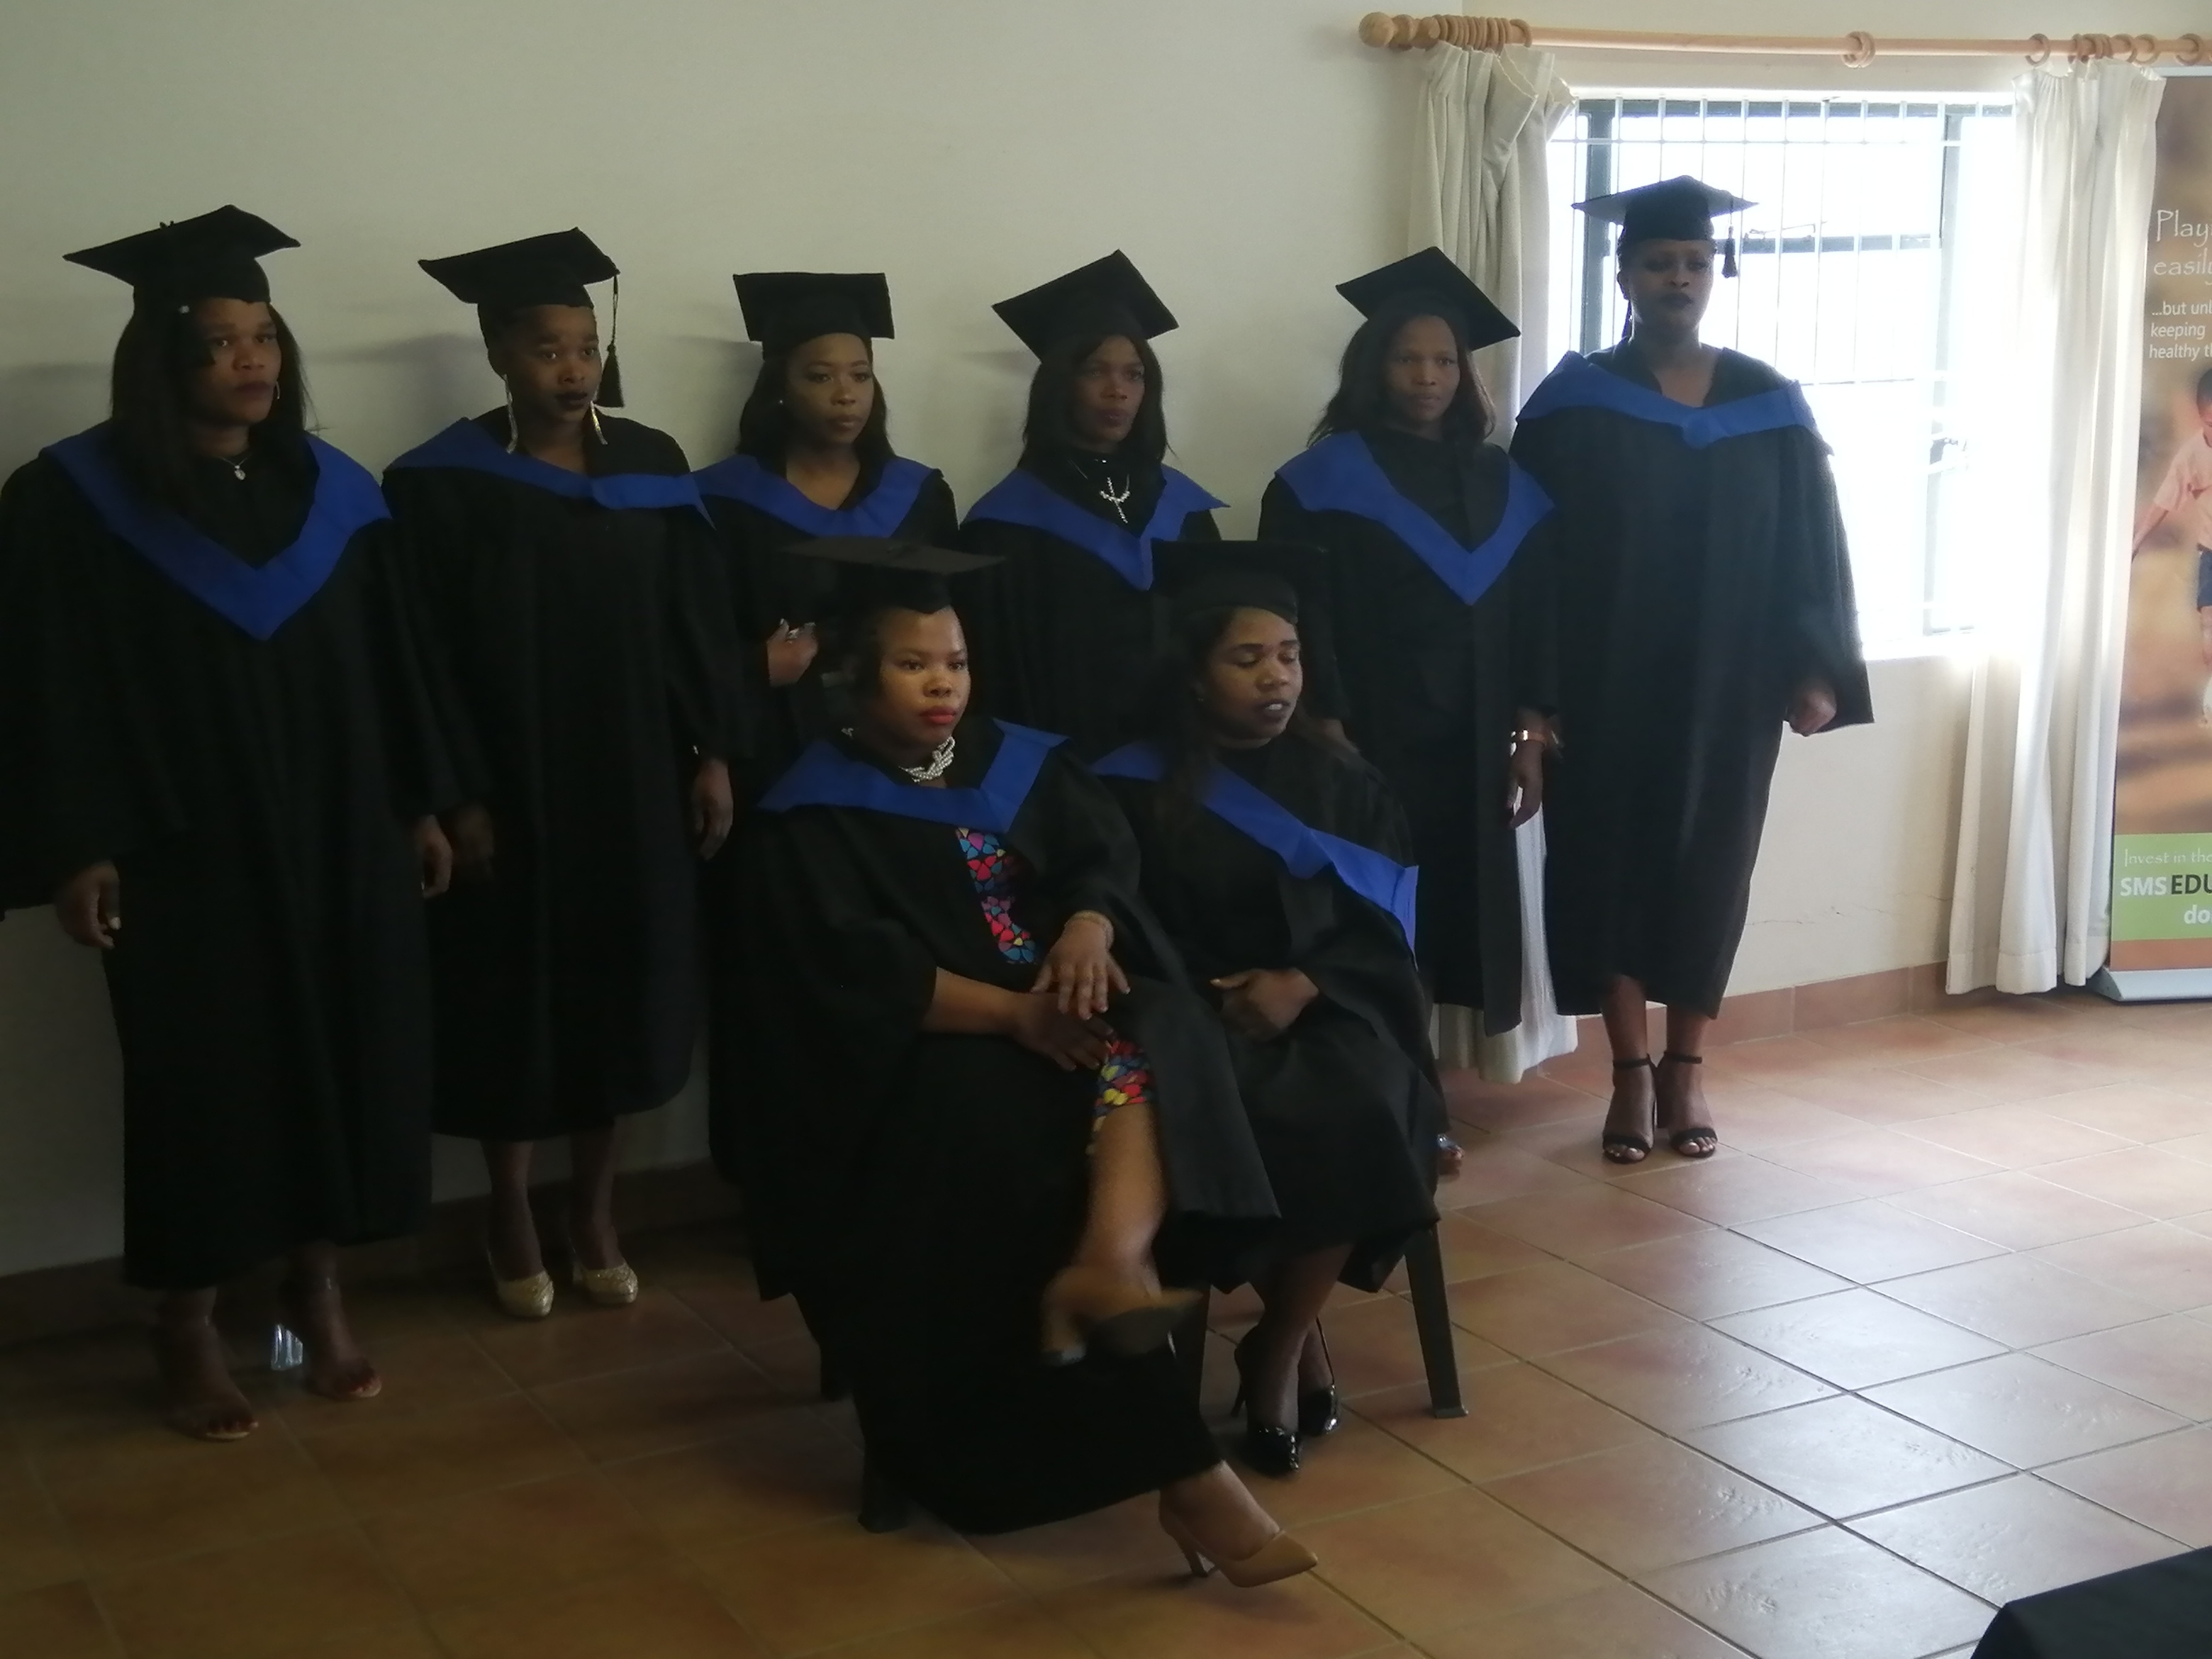
HPSA CERTIFICATE CEREMONY

Slide 15
Outcome
Knowledge – Attitude - Behaviour affects leading to change of
Knowledge
from health education
Attitude
E.g., increased health awareness
Behavior
E.g., adoption of healthy lifestyle.

Slide 16




CASCADING EFFECT.
Main trainee
Family
Acquaintance
Neighbor
Friend
Colleague

Slide 17
Thank You!

